Slide 1
Prediction of Heart Attack Risk Using Machine Learning
HRISHABH V

Slide 2
Objectives
Develop a Machine Learning Model
Analyze Feature Impact
Provide Actionable Insights

Slide 3
Data Set Overview
Training set size : 237
Testing set size : 60

Slide 4
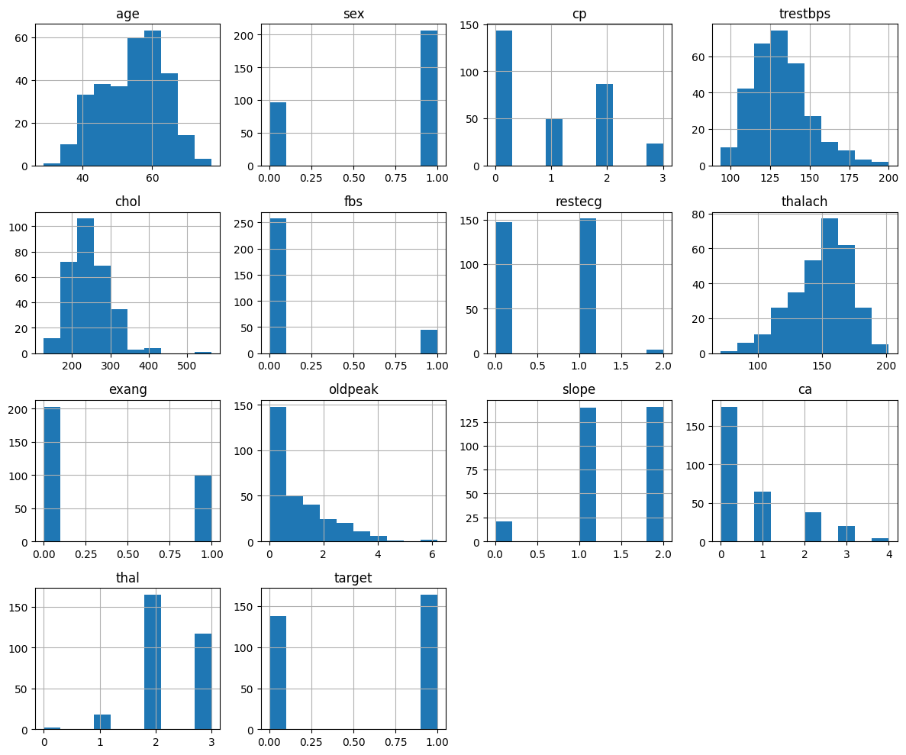
Data Summary

Slide 5
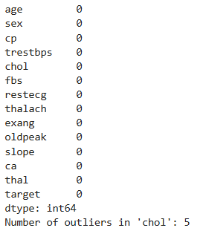
Cleaning data
Check for missing values
Dropping rows for missing values
Handling outliers
Convert categorical data to dummy variables

Slide 6
Flowchart
Data collection
Data Preprocessing
Data Splitting
Model training
Feature importance analysis
Model evaluation
Hyper parameter tuning

Slide 7
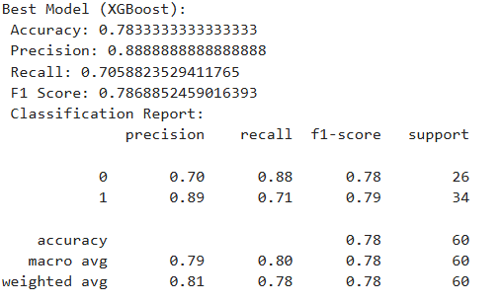
Evaluation

Slide 8
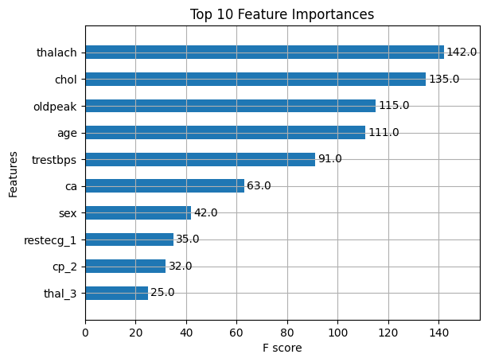
Important Features

Slide 9
Analysis
From our analysis, we derived several key insights:
Significant Features: Features like cholesterol levels and maximum heart rate are critical in predicting heart attack risk.
Practical Implications: These insights can assist healthcare professionals in prioritizing diagnostic tests and interventions for patients at higher risk.
Integrating such predictive models into clinical practice can enhance early detection and treatment of heart disease

Slide 10
In conclusion, we successfully developed a machine learning model to predict heart attack risk and identified key factors influencing this risk. The model’s performance and insights provide valuable information for improving patient care

Slide 11
Thank YOU

